Slide 1
OPERATING SYSTEMS
Razi Uddin
Lecture # 27

Slide 2


Implementation of Page Table
In CPU Registers:
This is OK for small process address spaces and large page sizes. It has the advantage of having effective memory access time (Teffective) about the same as memory access time (Tmem).
In the main memory:
A page table base register (PTBR) is needed to point to the page table. With page table in main memory, the effective memory access time, Teffective, is 2Tmem , which is not acceptable because it would slow down program execution by a factor of two.
In the translation look-aside buffer (TLB):
A solution to this problem is to use special, small, fast lookup hardware, called translation look-aside buffer (TLB), which typically has 64–1024 entries. Each entry is (key, value). The key is searched for in parallel; on a hit, value is returned. The (key,value) pair is (p,f) for paging. For a logical address, (p,d), TLB is searched for p. If an entry with a key p is found, we have a hit and f is used to form the physical address. Else, page table in the main memory is searched.

Slide 3
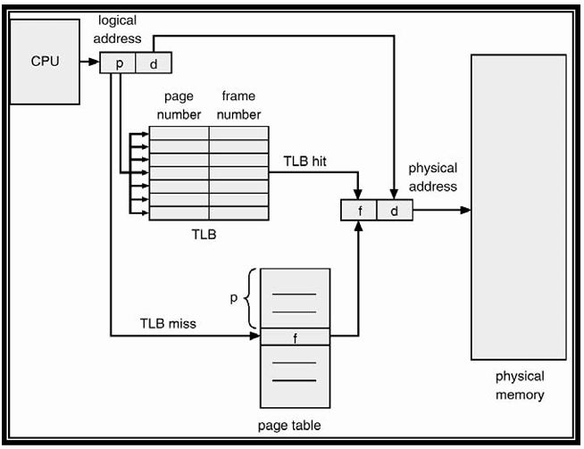

Slide 4
Translation look-aside buffer
The TLB is loaded with the (p,f) pair so that future references to p are found in the TLB, resulting in improved hit ratio.
On a context switch, the TLB is flushed and is loaded with values for the scheduled process
If HR is hit ratio equation and MR is miss ratio the effective access time is given by the following
Teffective = HR (TTLB + Tmem) + MR (TTLB + 2Tmem)

Slide 5
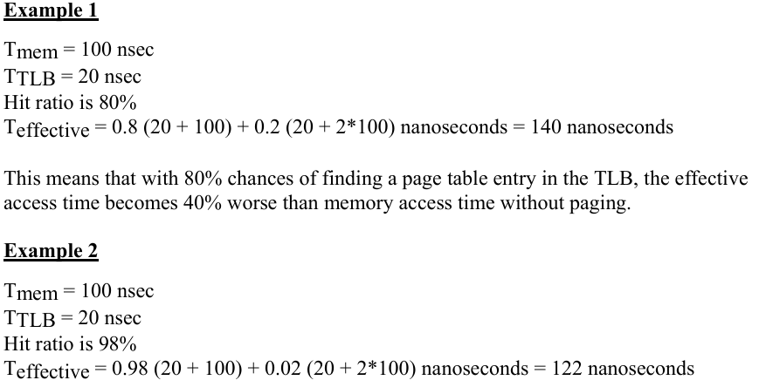

Slide 6
This means that with 98% chances of finding a page table entry in the TLB, the effective access time becomes 22% worse than memory access time without paging. This means that with a small cache and good hit ratio, we can maintain most of the page table in the main memory and get much better performance than keeping the page table in the main memory and not using any cache.

Slide 7
Structure of the Page Table
As logical address spaces become large (32-bit or 64-bit), depending on the page size, page table sizes can become larger than a page and it becomes necessary to page the page the page table. Additionally, large amount of memory space is used for page table.
The following schemes allow efficient implementations of page tables.
Hierarchical / Multilevel Paging
Hashed Page Table
Inverted Page Table

Slide 8
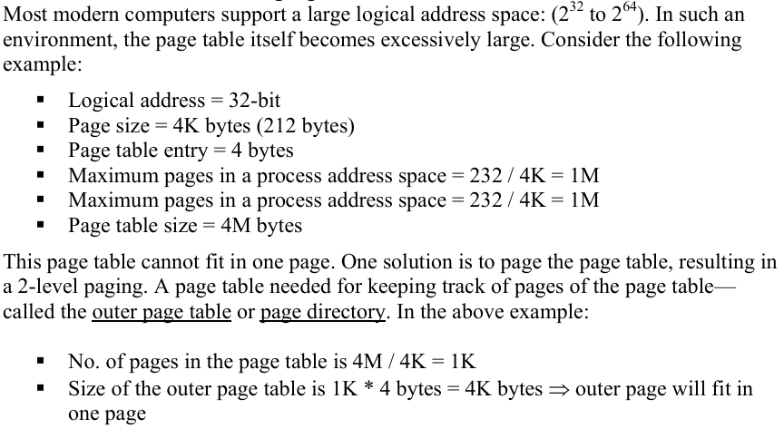
Hierarchical / Multilevel Paging

Slide 9
Hierarchical / Multilevel Paging
In the 32-bit machine described above, we need to partition p into two parts, p1 and p2. p1 is used to index the outer page table and p2 to index the inner page table.
Thus the logical address is divided into a page number consisting of 20 bits and a page offset of 12 bits.
Since we page the page table, the page number is further divided into a 10-bit page number, and a 10-bit page offset. This is known as two-level paging.

Slide 10
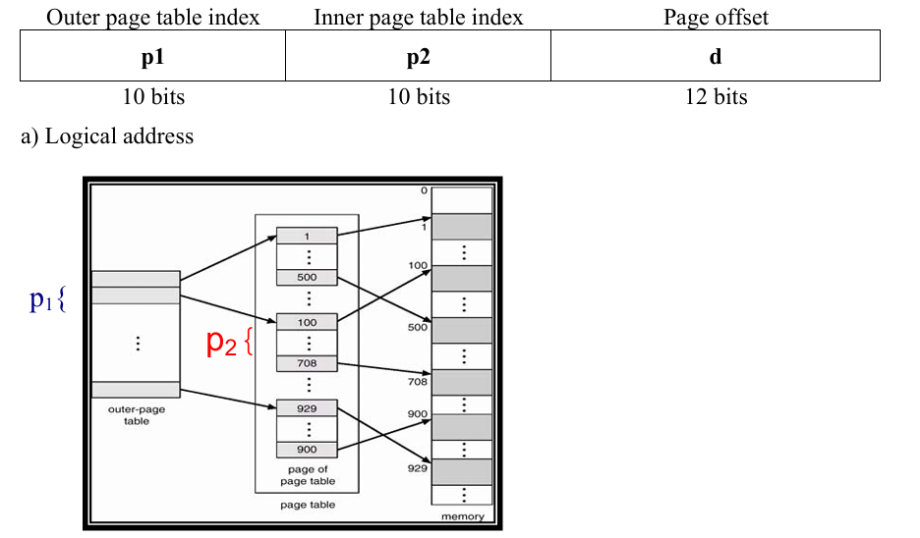

Slide 11
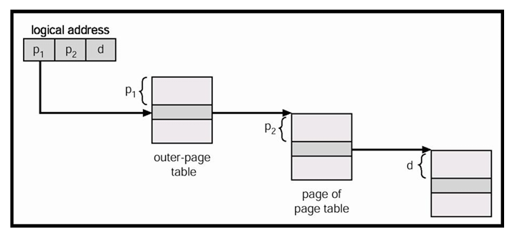

Slide 12
Hashed Page Table
This is a common approach to handle address spaces larger then 32 bits .Usually open hashing is used.
Each entry in the linked list has three fields: page number, frame number for the page, and pointer to the next element—(p, f, next).
The page number in the logical address (specified by p) is hashed to get index of an entry in the hash table.
This index is used to search the linked list associated with this entry to locate the frame number corresponding to the given page number.
The advantage of hashed page tables is smaller page tables

Slide 13
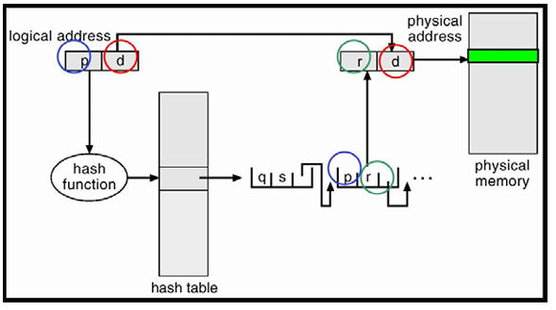
Hashed Page Table

Slide 14
Inverted Page Table
Usually each process has a page table associated with it. The page table has one entry for each page in the address space of the process. For large address spaces (32-bit and above), each page table may consist of millions of entries. These tables may consume large amounts of physical memory, which is required just to keep track of how the mapping of logical address spaces of processes onto the physical memory.
A solution is to use an inverted page table. An inverted page table has one entry for each real page (frame) of memory. Each entry consists of the virtual address of the page stored in that real memory location, with information about the process that own the page.
Page table size is limited by the number of frames (i.e., the physical memory) and not process address space. Each entry in the page table contains (pid, p). If a page ‘p’ for a process is loaded in frame ‘f’, its entry is stored at index ‘f’ in the page table. We effectively index the page table with frame number; hence the name inverted page table.

Slide 15
